Slide 1

Group 22 Final Presentation 2nd Year Team Project 2021
By
Shane Mulrooney
Sean Fulton
Cree Gunning

Slide 2


Application Idea
Our Love for games
Fun but challenging experience
No end objective
Round based format

Slide 3


Target Audience
For People Who love games as much as us
Fans of top down style games
Fans of round based survival games

Slide 4
Technology and software used

Slide 5
Project Plan

Slide 6
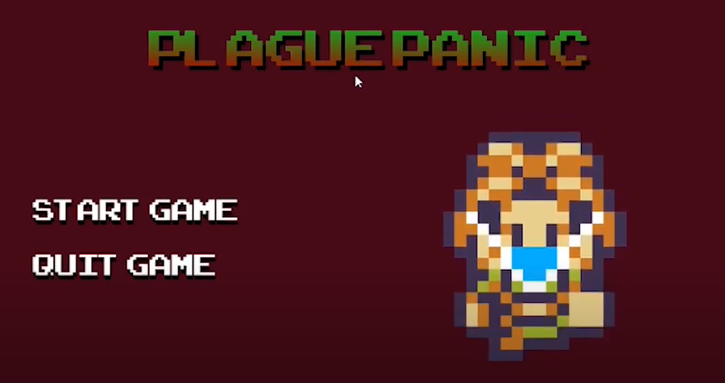
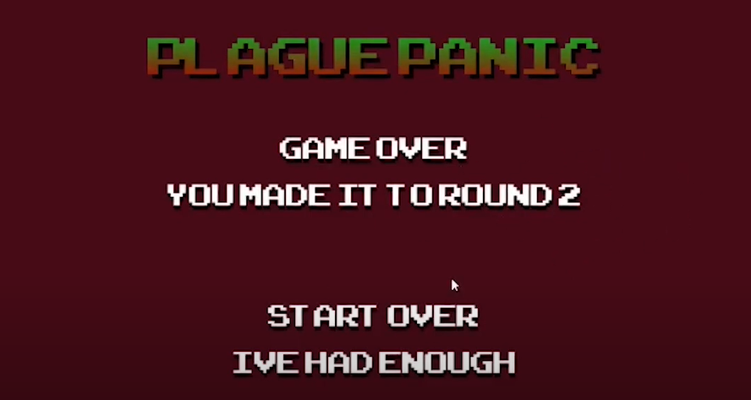
individual responsibilites
Shane
Project manager
Main menu
Cutscene
Game over
Music and sound
Player Walk Mechanic

Slide 7
Challenges Overcame

